Slide 1
#10yearchallenge
Nicolas, Stamati and Mitchell

Slide 2


Slide 3
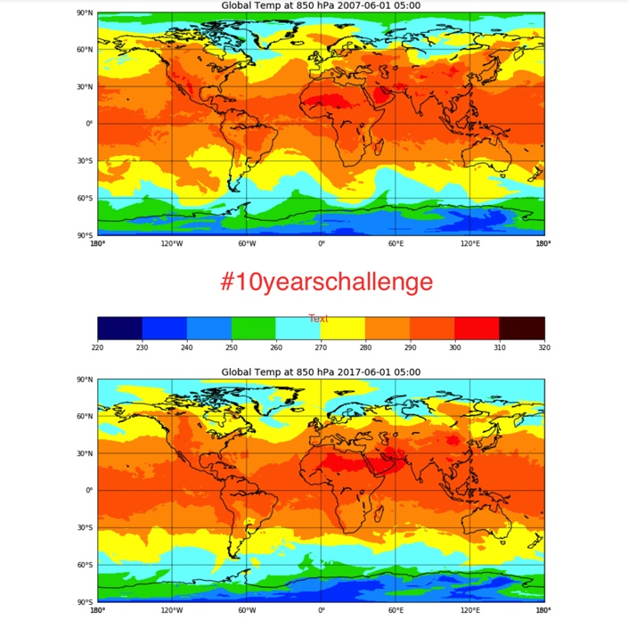
10 Year Temperature Change
Arctic Temperature Increase
Top of Africa Warmer

Slide 4
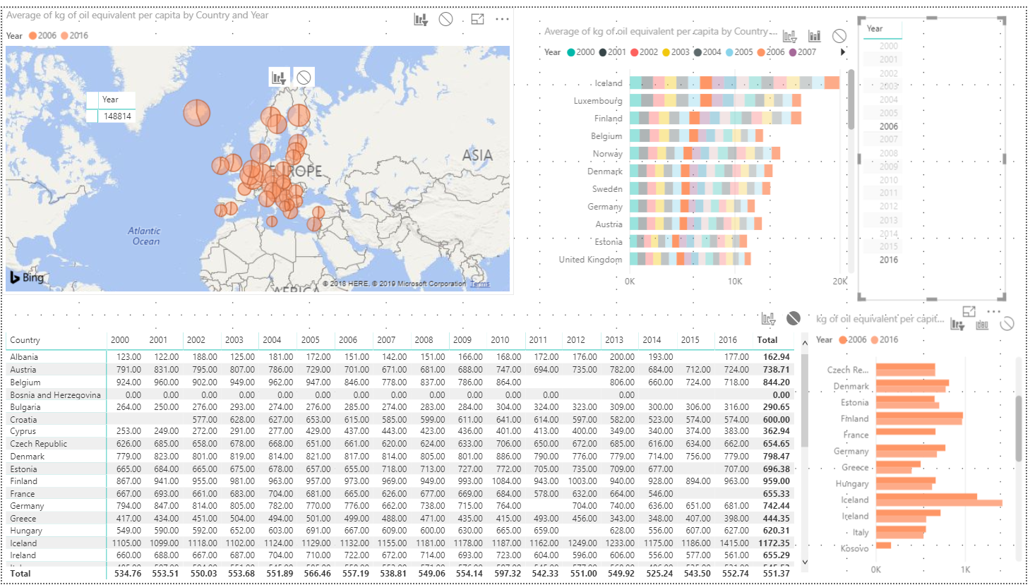
Change in Energy Consumption per capita shows little change except Albania and Austria and significantly Iceland

Slide 5
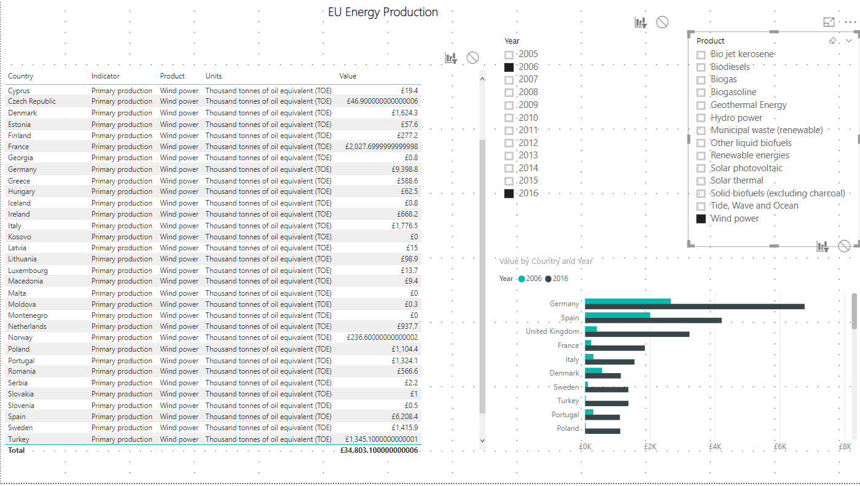

Slide 6
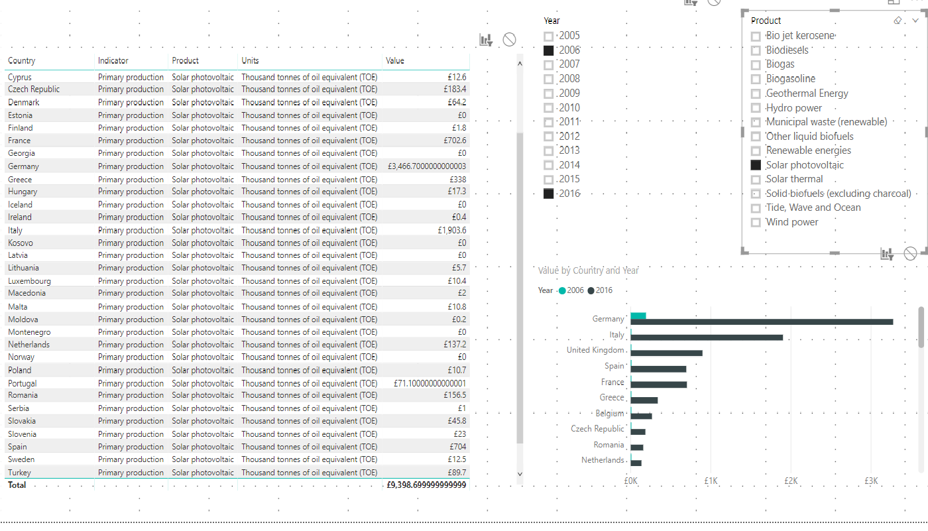

Slide 7
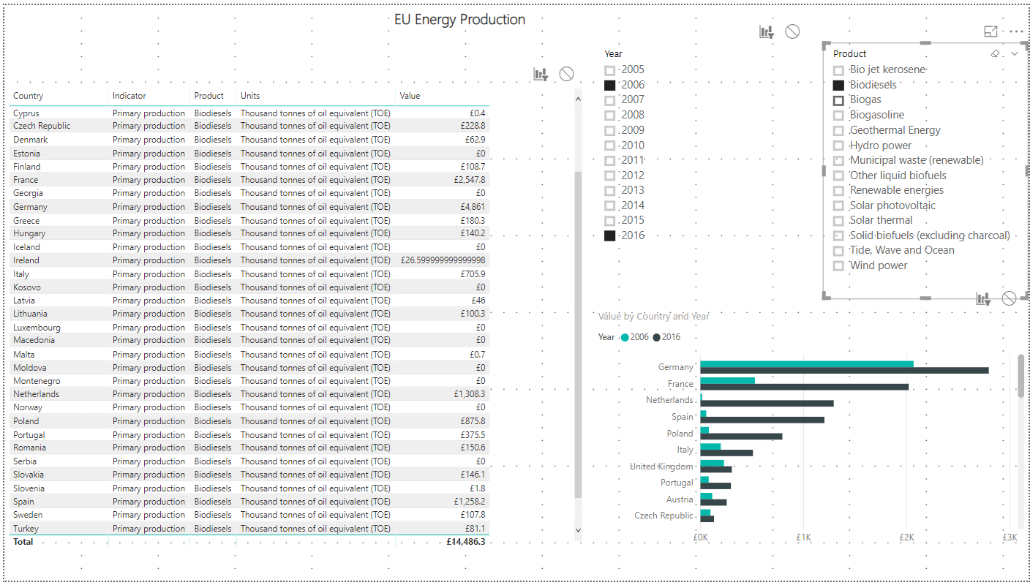

Slide 8
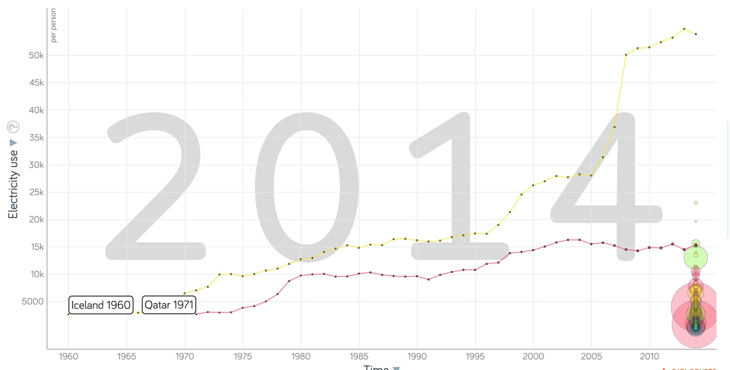
Source Gapminder…
Showing increase in per capita electricity for Qatar and Iceland (two highest in the world).

Slide 9
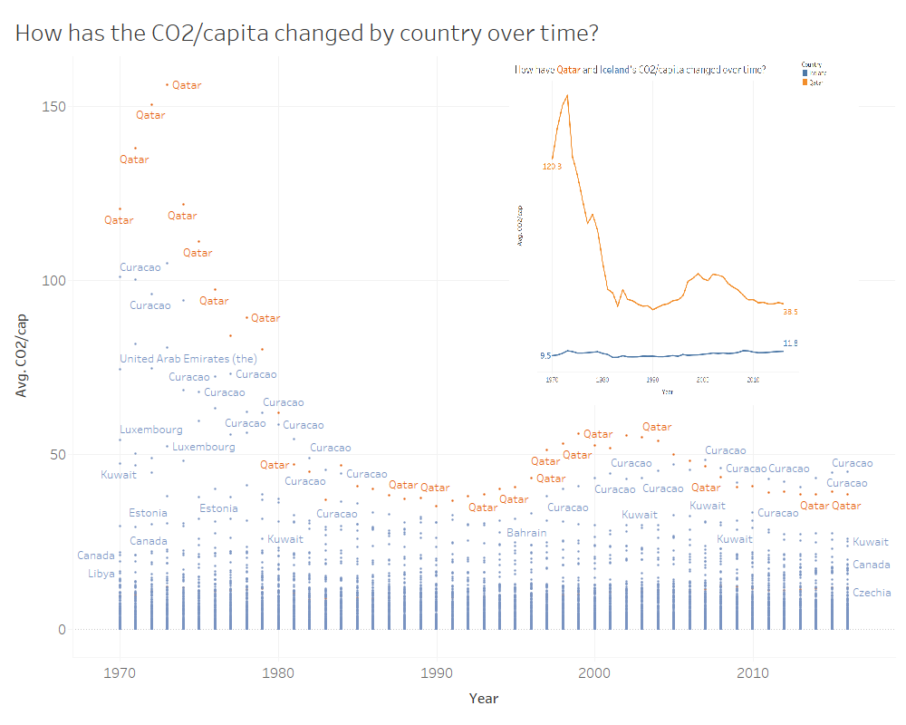

Slide 10
